Slide 1
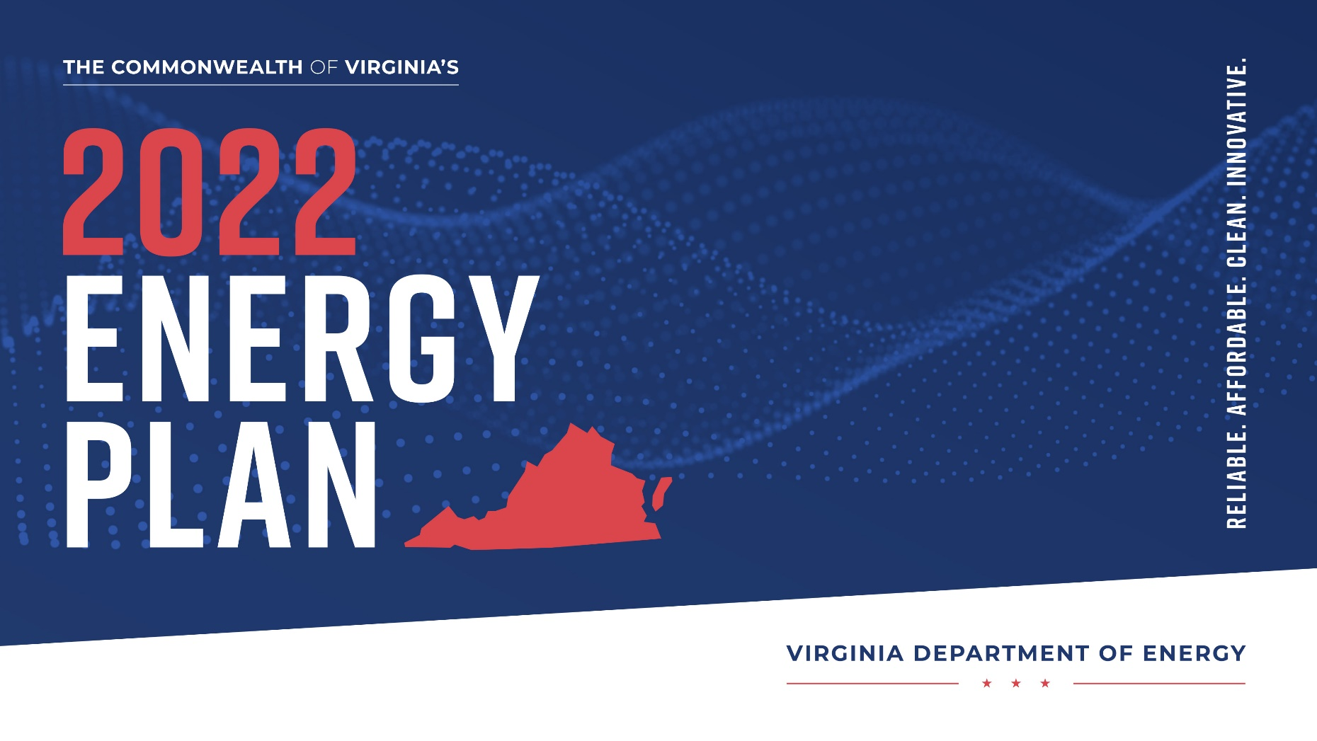

Virginia energy plan execution update
Will Clear
Deputy Director
Virginia Nuclear Energy Consortium Authority
4/21/2023

Slide 2
Virginia energy plan execution update
VIRGINIA ENERGY MODELS
Model #1- SMR Affordability
Goal: Determine cost of SMR relative to other generation sources to ensure that ratepayers are not severely impacted in the move toward advanced nuclear.
Preliminary Findings:
The first SMRs are going to be $100 per MWh significantly above other current sources of generation such as new natural gas combined cycle at MWh approximately $70.
Costs will decline over time as most experts believe that NOAK will be reached after 30-50 cores are deployed.
Federal benefits under the IRA will reduce overall costs by up to 50% making SMRs cost competitive
Model demonstrated that incorporating SMRs could present a path that is cheaper than VCEA’s model.
Model #2- VCEA Alternative
Goal: Develop a path that creates better energy reliability and affordability by incorporating SMR’s into the VCEA framework
Model Suppositions:
SMRs incorporated in lieu of battery storage will be more reliable and affordable.
SMRs will provide additional benefits, like hydrogen production on off-peak hours and waste heat to power industrial applications. The model will value those benefits by capturing GHG reduction gains.
Additional hydrogen production will provide energy security by displacing imported natural gas
Model #3- Virginia Detail Energy Profile
Goal: Evaluate Virginia’s full energy mix to better understand optimal energy path
Whole energy approach will evaluate the flaws in VCEA that exclude transportation and industrial applications from the plan
Model will incorporate the higher growth view on demand forecast and will identify soft spots in energy landscape
With the Energy Profile developed, work can commence on full plan to meet energy demand taking the holistic approach, which will provide a more well-rounded solution.

Slide 3

Virginia energy plan execution update
STATE ENERGY OFFICE REORGANIZATION
Old Configuration:
RENEWABLE ENERGY AND ENERGY EFFICIENCY PROGRAM
New Configuration: STATE ENERGY OFFICE
Reliability Team
Affordability Team
Innovation Team
Notes:
Director of Research & Analysis
Job objectives:
1. Understand utility rate structures & delivery of energy in Virginia.
2. Understanding impacts of federal and state policies on the ability to deliver reliable, affordable and increasingly clean energy to homes & businesses.
3. Developing briefings, reports and other analyses.
4. Manage University and other partner research projects.
Areas of Focus: grid resilience, innovative technology deployment, carbon capture,
Director of Energy Innovation & Deployment
1. Analysis of new & innovative energy technologies

Slide 4
VIRGINIAENERGY PLAN EXECUTION UPDATE
ENERGY grants today
FEDERAL ENERGY GRANTS
BY THE NUMBERS
CURRENT GRANT PLAN
 | $ Millions
Abandoned Mine Lands (formula) | 342
State Energy Plan Federal Grant (formula) | 9.5
Greenhouse Gas Reduction | 650
Clean Energy on Mined Lands | 100
High Efficiency Electric Home Rebates | 93
Comprehensive Home Rebates | 93
Grid Innovation | 50
Enhancing Resiliency of the Electric Grid | 27.5
Other | 8
Total | 1.44 Billion
 | $ BILLIONS
TOTAL FUNDING IRA AND BIL | 932
TOTAL ENERGY FUNDING | 567
TOTAL ENERGY GRANT FUNDING *open or coming soon | 85.1
TOTAL PERSUED BY VIRGINIA ENERGY *estimated based on understanding of opportunities | 1.44
Notes:
Takeaways:
GHG reduction is almost half of funding
Add two rebates plus GHG funding and over half of competitive federal funding is for homeowners

Slide 5
Virginia energy plan execution update

